Slide 1

Analytical Modeling of Parallel Programs

Slide 2
Introduction
A sequential algorithm is usually evaluated in terms of its execution time, expressed as a function of the size of its input.
The execution time of a parallel algorithm depends not only on input size but also on the number of processing elements used, and their relative computation and inter-process communication speeds.
Hence, a parallel algorithm cannot be evaluated in isolation from a parallel architecture without some loss in accuracy.
A parallel system is the combination of an algorithm and the parallel architecture on which it is implemented.

Slide 3
Introduction
A number of measures of performance are intuitive.
Perhaps the simplest of these is the wall clock time taken to solve a given problem on a given parallel platform.
However, as we shall see, a single figure of merit of this nature cannot be extrapolated to other problem instances or larger machine configurations.
Other intuitive measures quantify the benefit of parallelism, i.e., how much faster the parallel program runs with respect to the serial program.
However, this characterization suffers from other drawbacks, in addition to those mentioned above.
For instance, what is the impact of using a poorer serial algorithm that is more “open to” to parallel processing?
For these reasons, more complex measures for extrapolating performance to larger machine configurations or problems are often necessary.

Slide 4
Sources of Overhead in Parallel Programs
Section 5.1

Slide 5
Sources of Overhead in Parallel Programs
Using twice as many hardware resources, one can reasonably expect a program to run twice as fast.
However, in typical parallel programs, this is rarely the case, due to a variety of overheads associated with parallelism.
An accurate quantification of these overheads is critical to the understanding of parallel program performance.
A typical execution profile of a parallel program is illustrated in Figure in next slide.
In addition to performing essential computation (i.e., computation that would be performed by the serial program for solving the same problem instance), a parallel program may also spend time in inter-process communication, idling, and excess computation (computation not performed by the serial formulation).

Slide 6
Sources of Overhead in Parallel Programs
Notes:
The execution profile of a hypothetical parallel program executing on eight processing elements. Profile indicates times spent performing computation (both essential and excess), communication, and idling.

Slide 7
Sources of Overhead in Parallel Programs
Inter-process Interaction: Any nontrivial parallel system requires its processing elements to interact and communicate data (e.g., intermediate results). The time spent communicating data between processing elements is usually the most significant source of parallel processing overhead.
Idling: Processing elements in a parallel system may become idle due to many reasons such as load imbalance, synchronization, and presence of serial components in a program.
Excess Computation: The fastest known sequential algorithm for a problem may be difficult or impossible to parallelize, forcing us to use a parallel algorithm based on a poorer but easily parallelizable (that is, one with a higher degree of concurrency) sequential algorithm. The difference in computation performed by the parallel program and the best serial program is the excess computation overhead incurred by the parallel program.

Slide 8

Performance Metrics for Parallel Systems
Section 5.2

Slide 9
Execution Time
The serial runtime of a program is the time elapsed between the beginning and the end of its execution on a sequential computer.
The parallel runtime is the time that elapses from the moment a parallel computation starts to the moment the last processing element finishes execution.
We denote the serial runtime by TS and the parallel runtime by TP.

Slide 10
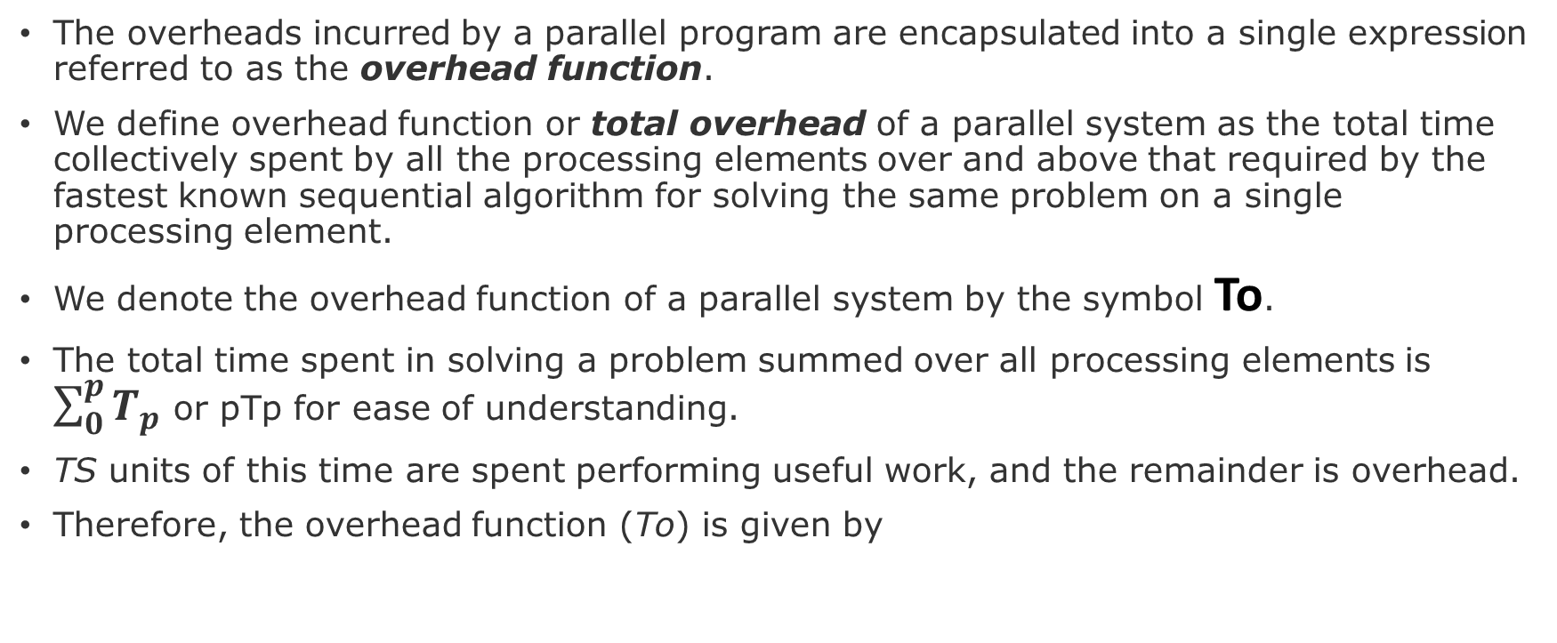
Total Parallel Overhead
The overheads incurred by a parallel program are encapsulated into a single expression referred to as the overhead function.
We define overhead function or total overhead of a parallel system as the total time collectively spent by all the processing elements over and above that required by the fastest known sequential algorithm for solving the same problem on a single processing element.
We denote the overhead function of a parallel system by the symbol To.
The total time spent in solving a problem summed over all processing elements is $\sum_{0}^{p}{T_{p}}$ or pTp for ease of understanding.
TS units of this time are spent performing useful work, and the remainder is overhead.
Therefore, the overhead function (To) is given by

Slide 11
Speedup
When evaluating a parallel system, we are often interested in knowing how much performance gain is achieved by parallelizing a given application over a sequential implementation.
Speedup is a measure that captures the relative benefit of solving a problem in parallel.
It is defined as the ratio of the time taken to solve a problem on a single processing element to the time required to solve the same problem on a parallel computer with p identical processing elements.
We denote speedup by the symbol S.
Reading assignment: Example 5.1, 5.2, 5.3, 5.4

Slide 12
Efficiency
Only an ideal parallel system containing p processing elements can deliver a speedup equal to p.
In practice, ideal behavior is not achieved because while executing a parallel algorithm, the processing elements cannot devote 100% of their time to the computations of the algorithm.
Part of the time required by the processing elements to compute the sum of n numbers is spent idling (and communicating in real systems).
Efficiency is a measure of the fraction of time for which a processing element is usefully employed; it is defined as the ratio of speedup to the number of processing elements.

Slide 13
Efficiency
In an ideal parallel system, speedup is equal to p and efficiency is equal to one.
In practice, speedup is less than p and efficiency is between zero and one, depending on the effectiveness with which the processing elements are utilized. We denote efficiency by the symbol E.
Mathematically, it is given by

Slide 14
Cost
We define the cost of solving a problem on a parallel system as the product of parallel runtime and the number of processing elements used.
Cost reflects the sum of the time that each processing element spends solving the problem.
Efficiency can also be expressed as the ratio of the execution time of the fastest known sequential algorithm for solving a problem to the cost of solving the same problem on p processing elements.
The cost of solving a problem on a single processing element is the execution time of the fastest known sequential algorithm.

Slide 15
Cost
A parallel system is said to be cost-optimal if the cost of solving a problem on a parallel computer has the same asymptotic growth (in Θ terms) as a function of the input size as the fastest-known sequential algorithm on a single processing element.
Since efficiency is the ratio of sequential cost to parallel cost, a cost-optimal parallel system has an efficiency of Θ(1).
Cost is sometimes referred to as work or processor-time product, and a cost-optimal system is also known as a pTP -optimal system.

Slide 16
The Effect of Granularity on Performance
Section 5.3

Slide 17
The Effect of Granularity on Performance
In practice, we assign larger pieces of input data to processing elements.
This corresponds to increasing the granularity of computation on the processing elements.
Using fewer than the maximum possible number of processing elements to execute a parallel algorithm is called scaling down a parallel system in terms of the number of processing elements.
A naive way to scale down a parallel system is to design a parallel algorithm for one input element per processing element, and then use fewer processing elements to simulate a large number of processing elements.

Slide 18
The Effect of Granularity on Performance
If virtual processing elements are mapped appropriately onto physical processing elements, the overall communication time does not grow by more than a factor of n/p.
The total parallel runtime increases, at most, by a factor of n/p, and the processor-time product does not increase.
Therefore, if a parallel system with n processing elements is cost-optimal, using p processing elements (where p < n)to simulate n processing elements preserves cost-optimality.
A drawback of this naive method of increasing computational granularity is that if a parallel system is not cost-optimal to begin with, it may still not be cost-optimal after the granularity of computation increases.

Slide 19
Scalability of Parallel Systems
Section 5.4

Slide 20
Scalability of Parallel Systems
Very often, programs are designed and tested for smaller problems on fewer processing elements.
However, the real problems these programs are intended to solve are much larger, and the machines contain larger number of processing elements.
Whereas code development is simplified by using scaled-down versions of the machine and the problem, their performance and correctness (of programs) is much more difficult to establish based on scaled-down systems.

Slide 21
Why is performance extrapolation so difficult?
Consider three parallel algorithms for computing an n-point Fast Fourier Transform (FFT) on 64 processing elements.
Figure on the next slide, illustrates speedup as the value of n is increased to 18 K.
Keeping the number of processing elements constant, at smaller values of n, one would infer from observed speedups that binary exchange and 3-D transpose algorithms are the best.
However, as the problem is scaled up to 18 K points or more, it is evident from Figure that the 2-D transpose algorithm yields best speedup.

Slide 22
Why is performance extrapolation so difficult?

Slide 23
The Iso-efficiency Metric of Scalability
We summarize the discussion in the sections above with the following two observations:
1. For a given problem size, as we increase the number of processing elements, the overall efficiency of the parallel system goes down. This phenomenon is common to all parallel systems.
2. In many cases, the efficiency of a parallel system increases if the problem size is increased while keeping the number of processing elements constant.

Slide 24
The Iso-efficiency Metric of Scalability
These two phenomena are illustrated in Figures in next slide, respectively.
Following from these two observations, we define a scalable parallel system as one in which the efficiency can be kept constant as the number of processing elements is increased, provided that the problem size is also increased.
It is useful to determine the rate at which the problem size must increase with respect to the number of processing elements to keep the efficiency fixed.
For different parallel systems, the problem size must increase at different rates in order to maintain a fixed efficiency as the number of processing elements is increased.
This rate determines the degree of scalability of the parallel system. As we shall show, a lower rate is more desirable than a higher growth rate in problem size.
Let us now investigate metrics for quantitatively determining the degree of scalability of a parallel system.
However, before we do that, we must define the notion of problem size precisely

Slide 25
The Iso-efficiency Metric of Scalability
Notes:
Variation of efficiency: (a) as the number of processing elements is increased for a given problem size; and (b) as the proble size is increased for a given number of processing elements. The phenomenon illustrated in graph (b) is not common to all parallel systems.

Slide 26
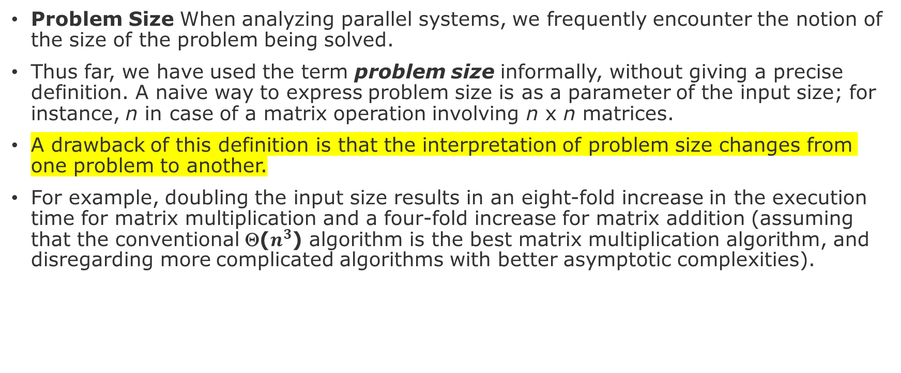
The Iso-efficiency Metric of Scalability
Problem Size When analyzing parallel systems, we frequently encounter the notion of the size of the problem being solved.
Thus far, we have used the term problem size informally, without giving a precise definition. A naive way to express problem size is as a parameter of the input size; for instance, n in case of a matrix operation involving n x n matrices.
A drawback of this definition is that the interpretation of problem size changes from one problem to another.
For example, doubling the input size results in an eight-fold increase in the execution time for matrix multiplication and a four-fold increase for matrix addition (assuming that the conventional Θ($n^{3}$) algorithm is the best matrix multiplication algorithm, and disregarding more complicated algorithms with better asymptotic complexities).

Slide 27
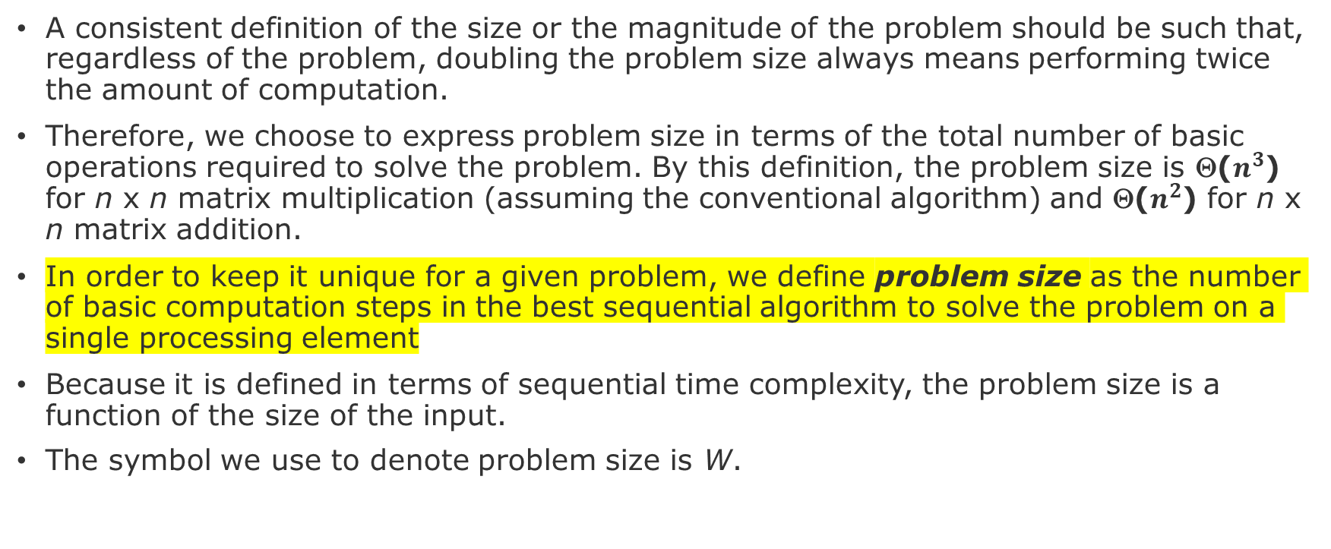
The Iso-efficiency Metric of Scalability
A consistent definition of the size or the magnitude of the problem should be such that, regardless of the problem, doubling the problem size always means performing twice the amount of computation.
Therefore, we choose to express problem size in terms of the total number of basic operations required to solve the problem. By this definition, the problem size is Θ($n^{3}$) for n x n matrix multiplication (assuming the conventional algorithm) and Θ($n^{2}$) for n x n matrix addition.
In order to keep it unique for a given problem, we define problem size as the number of basic computation steps in the best sequential algorithm to solve the problem on a single processing element
Because it is defined in terms of sequential time complexity, the problem size is a function of the size of the input.
The symbol we use to denote problem size is W.

Slide 28
Other Scalability Metrics
Section 3.7

Slide 29
Other Scalability Metrics
A number of other metrics of scalability of parallel systems have been proposed.
These metrics are specifically suited to different system requirements.
For example, in real time applications, the objective is to scale up a system to accomplish a task in a specified time bound.
One such application is multimedia decompression, where MPEG streams must be decompressed at the rate of 25 frames/second.
Consequently, a parallel system must decode a single frame in 40 ms (or with buffering, at an average of 1 frame in 40 ms over the buffered frames).

Slide 30
Other Scalability Metrics
Other such applications arise in real-time control, where a control vector must be generated in real-time.
Several scalability metrics consider constraints on physical architectures.
In many applications, the maximum size of a problem is constrained not by time, efficiency, or underlying models, but by the memory available on the machine.
In such cases, metrics make assumptions on the growth function of available memory (with number of processing elements) and estimate how the performance of the parallel system changes with such scaling.
In this section, we examine some of the related metrics and how they can be used in various parallel applications.

Slide 31
Other Scalability Metrics
Scaled Speedup This metric is defined as the speedup obtained when the problem size is increased linearly with the number of processing elements.
If the scaled-speedup curve is close to linear with respect to the number of processing elements, then the parallel system is considered scalable.
This metric is related to isoefficiency if the parallel algorithm under consideration has linear or near-linear isoefficiency function.
In this case the scaled-speedup metric provides results very close to those of isoefficiency analysis, and the scaled-speedup is linear or near-linear with respect to the number of processing elements.
For parallel systems with much worse isoefficiencies, the results provided by the two metrics may be quite different.
In this case, the scaled-speedup versus number of processing elements curve is sublinear.

Slide 32
Other Scalability Metrics
Two generalized notions of scaled speedup have been examined.
They differ in the methods by which the problem size is scaled up with the number of processing elements.
In one method, the size of the problem is increased to fill the available memory on the parallel computer.
The assumption here is that aggregate memory of the system increases with the number of processing elements.
In the other method, the size of the problem grows with p subject to an upper-bound on execution time.

Slide 33
Other Scalability Metrics
Serial Fraction f The experimentally determined serial fraction f can be used to quantify the performance of a parallel system on a fixed-size problem.
Consider a case when the serial runtime of a computation can be divided into a totally parallel and a totally serial component,
i.e.,
Here, Tser and Tpar correspond to totally serial and totally parallel components.
From this, we can write:
Here, we have assumed that all of the other parallel overheads such as excess computation and communication are captured in the serial component Tser.

Slide 34
Thank you ☺

